Slide 1
Stationary Robot (Industrial)
Muhammad Nazhan Bin Ramli
1816847

Slide 2
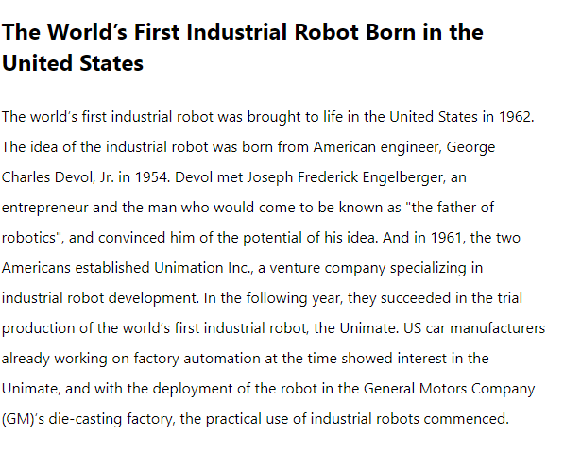
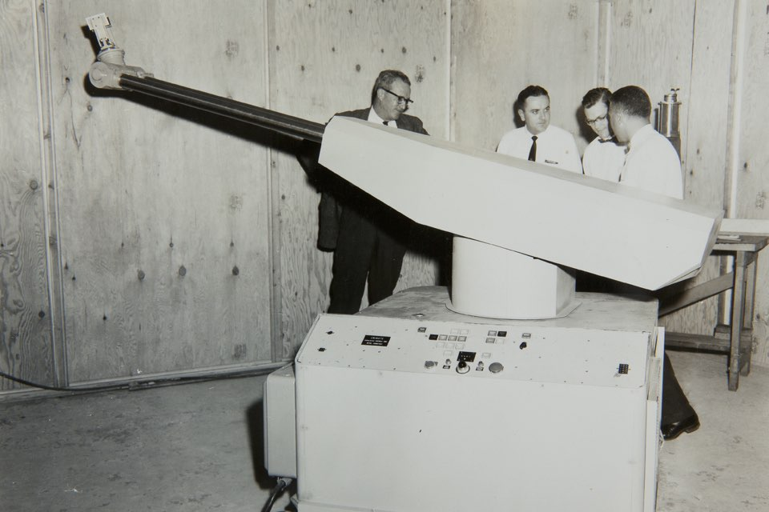
History of Industrial Robot

Slide 3
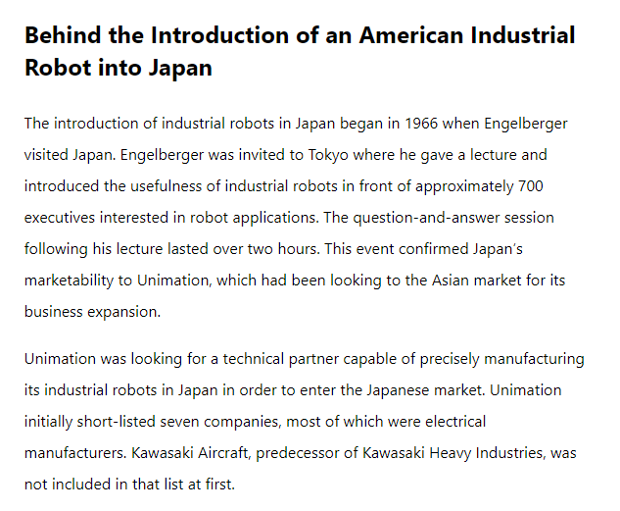
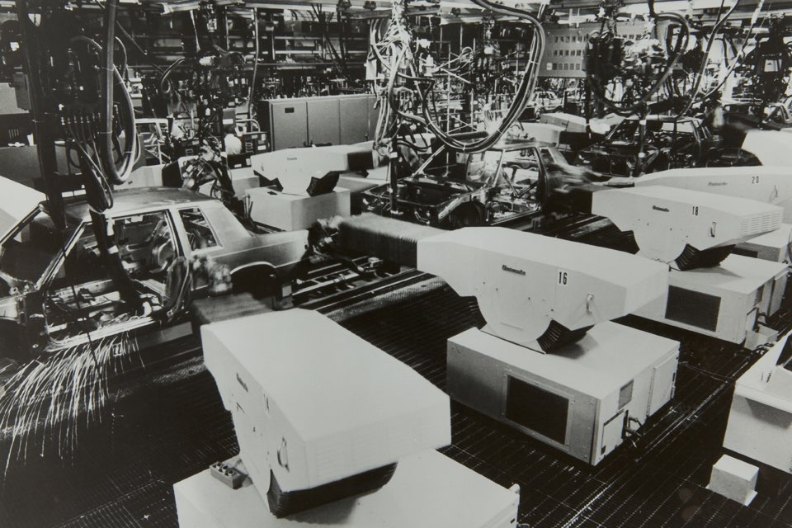
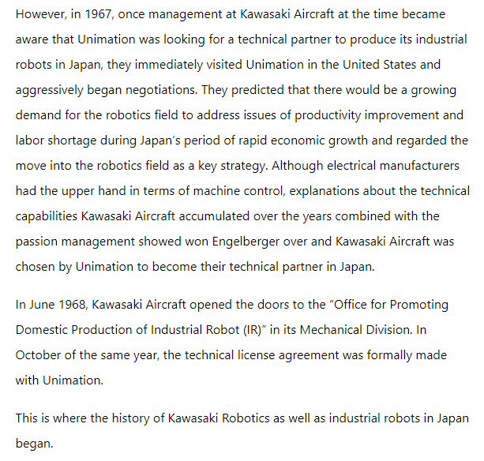

Slide 4
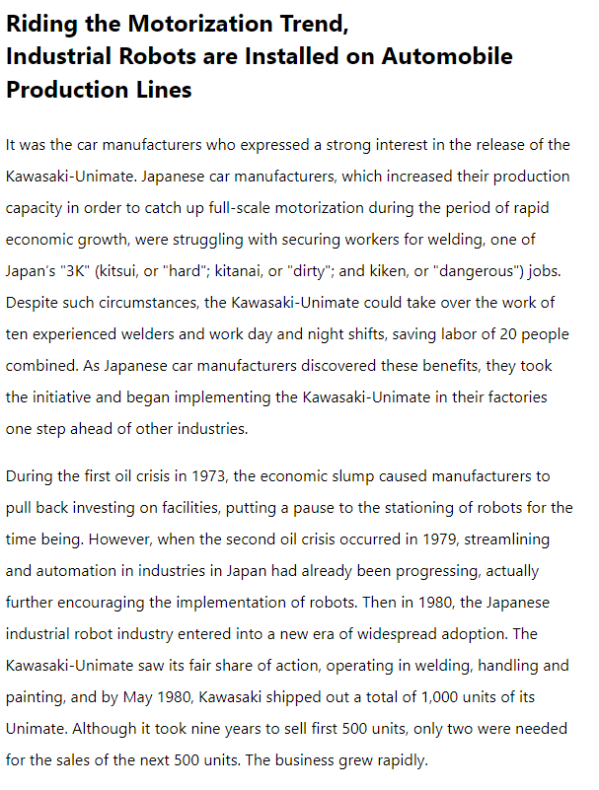
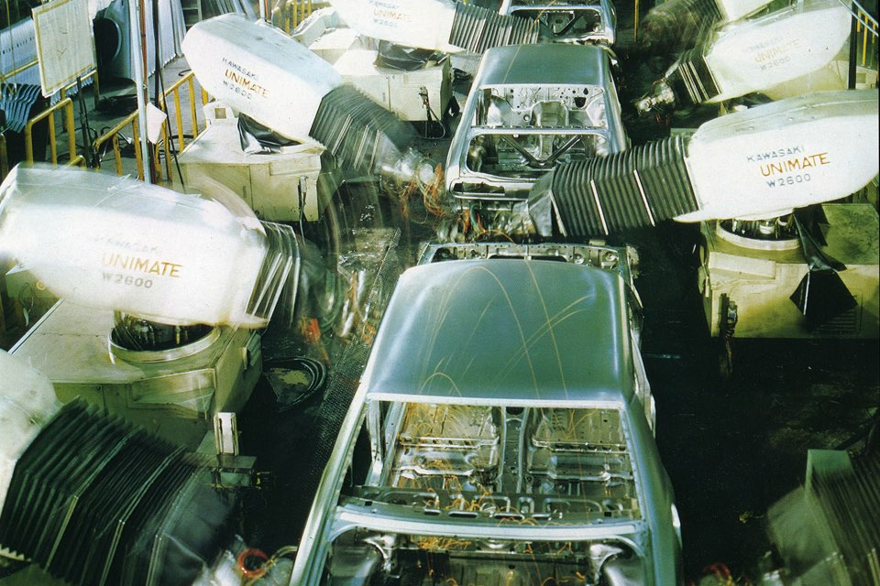

Slide 5
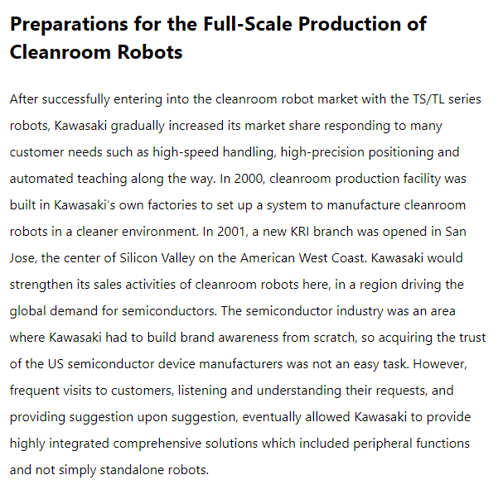
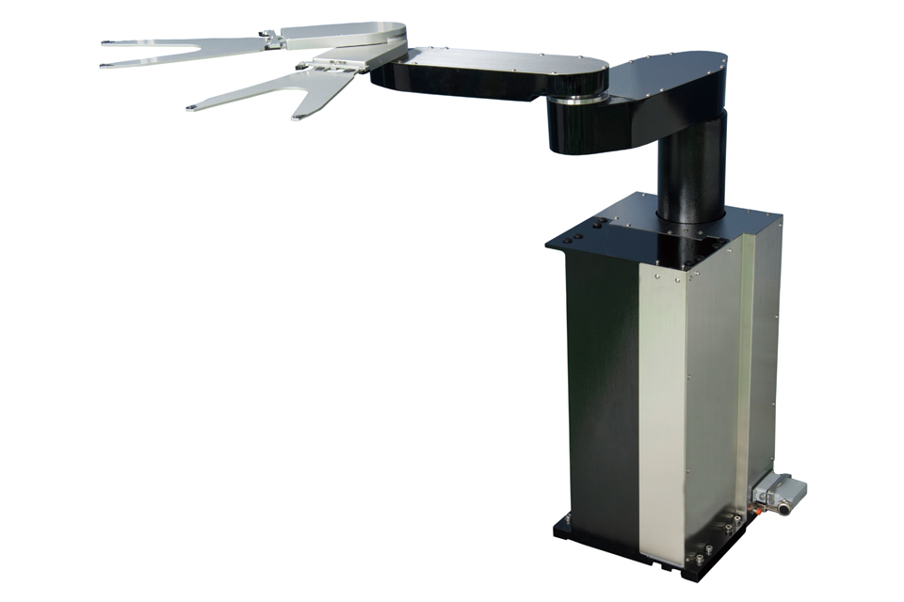

Slide 6
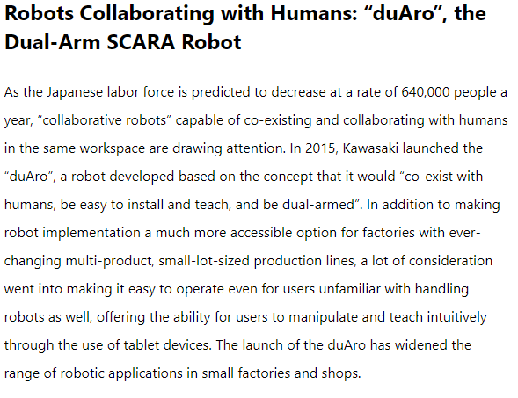
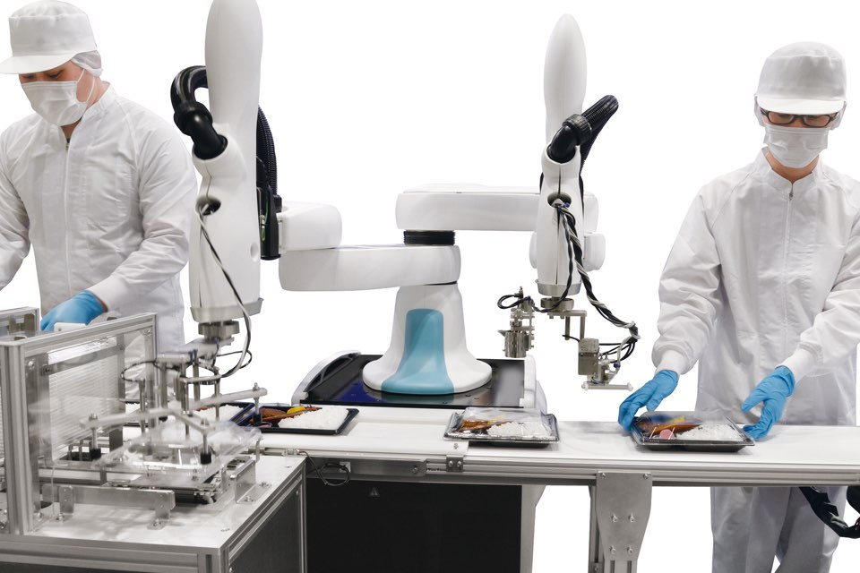

Slide 7
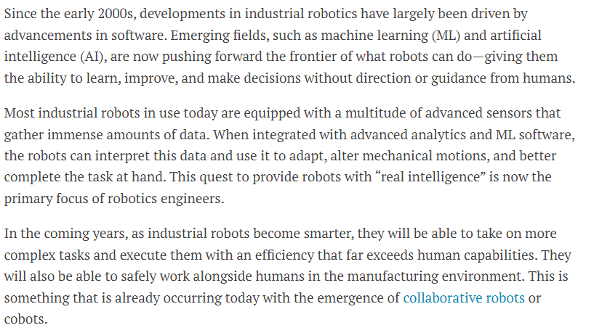
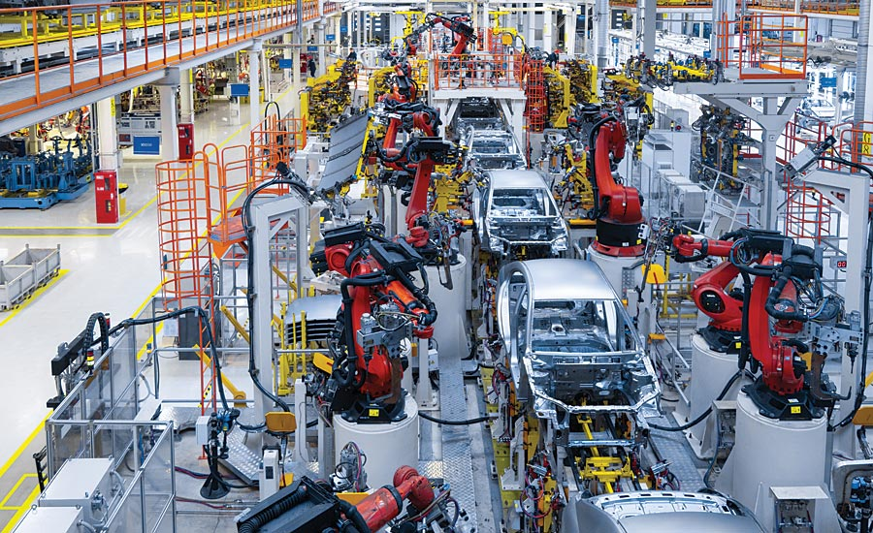
Industrial Robot Nowadays

Slide 8
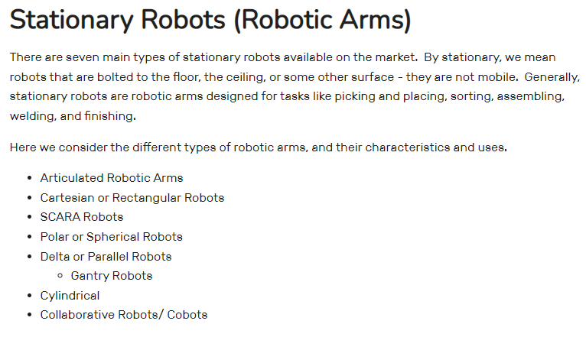

Slide 9
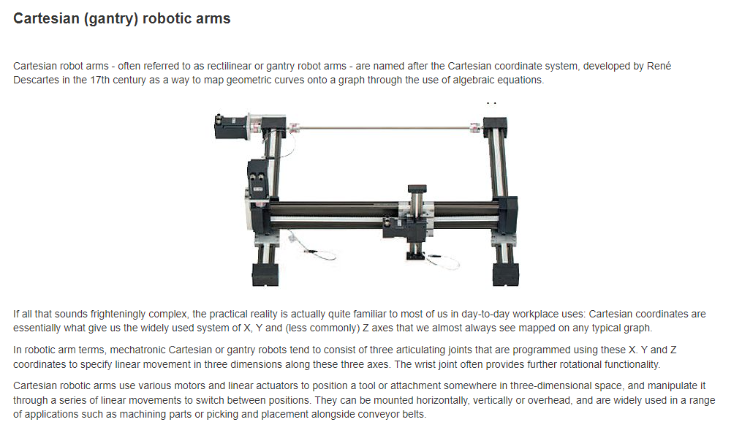

Slide 10
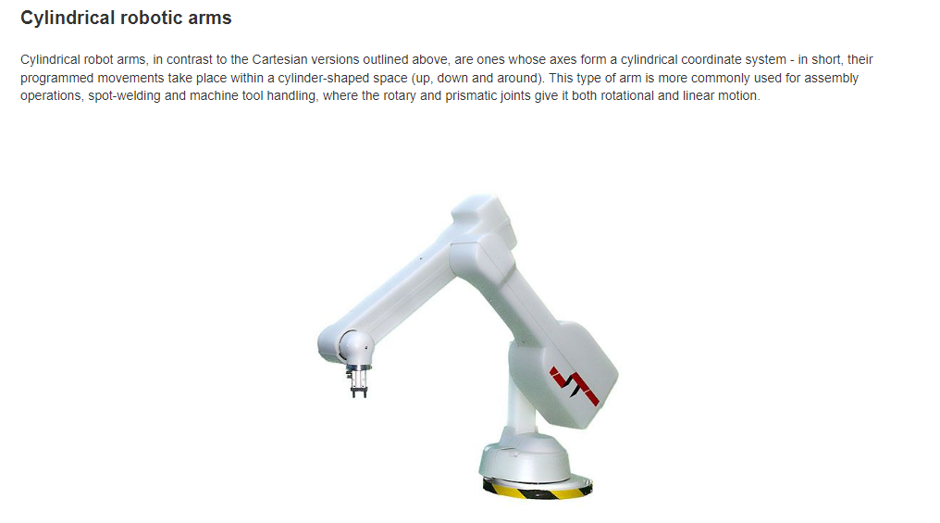

Slide 11
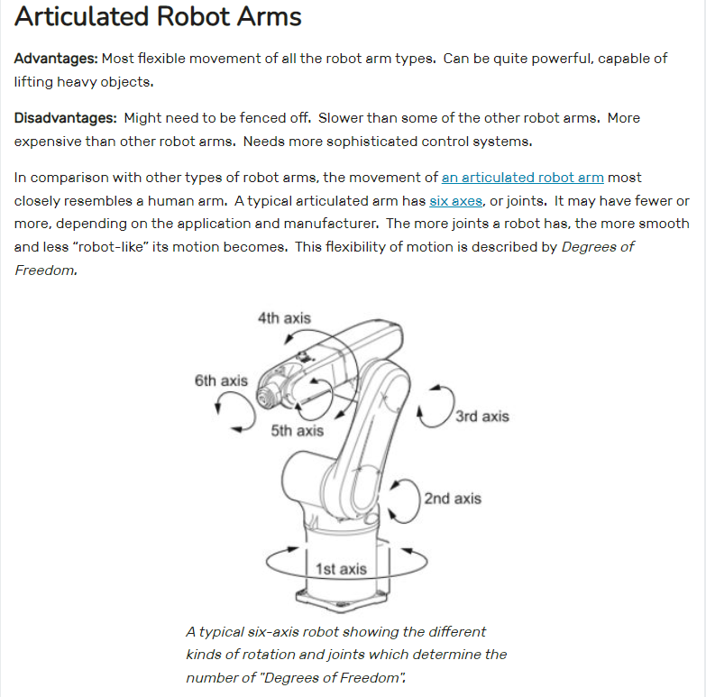

Slide 12
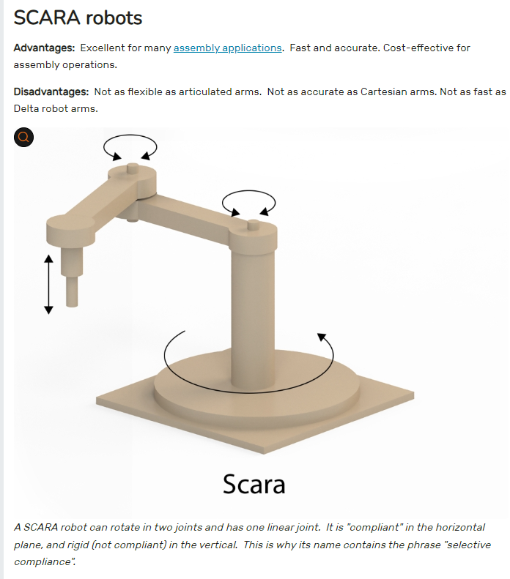
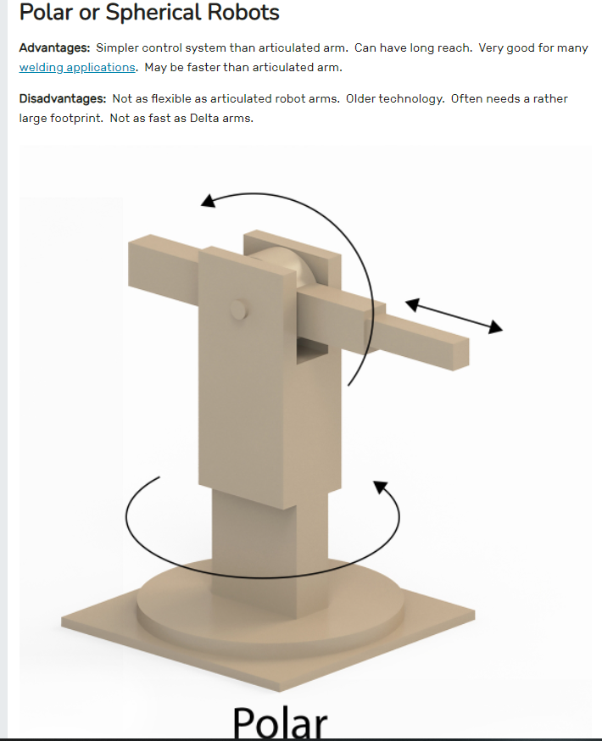

Slide 13
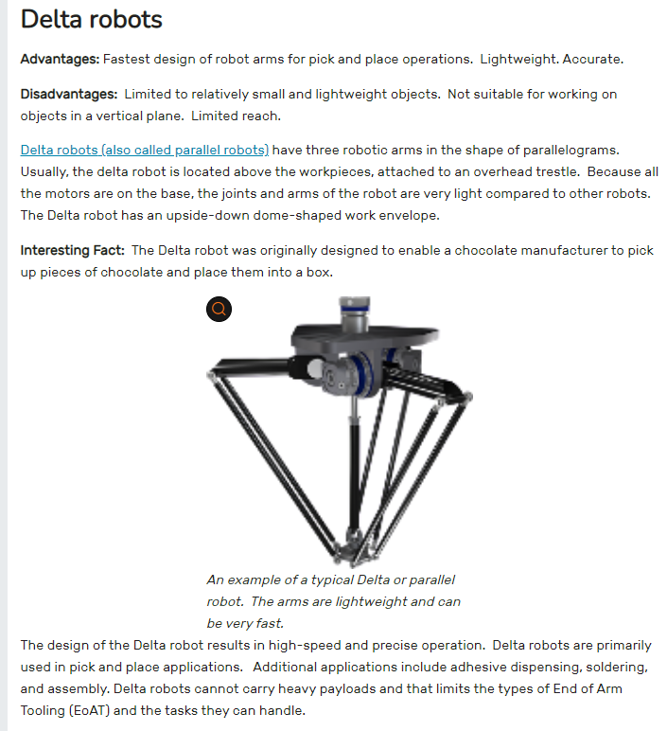

Slide 14
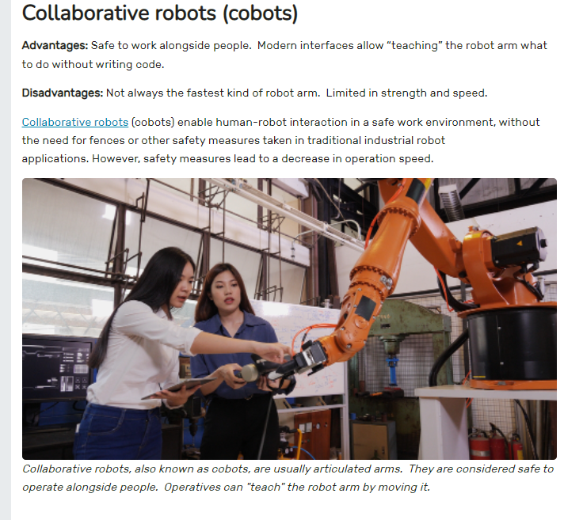

Slide 15
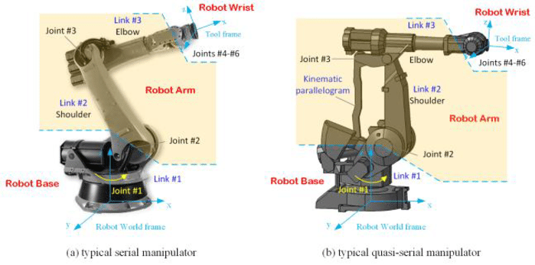
Basic System Architecture of Robotic Arm Robot

Slide 16
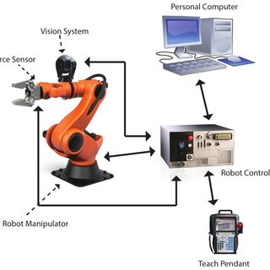
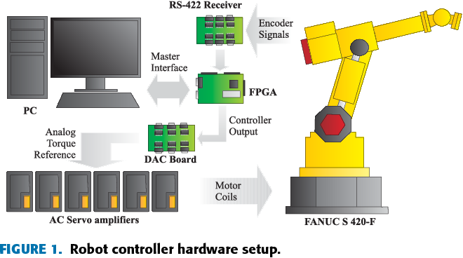

Slide 17
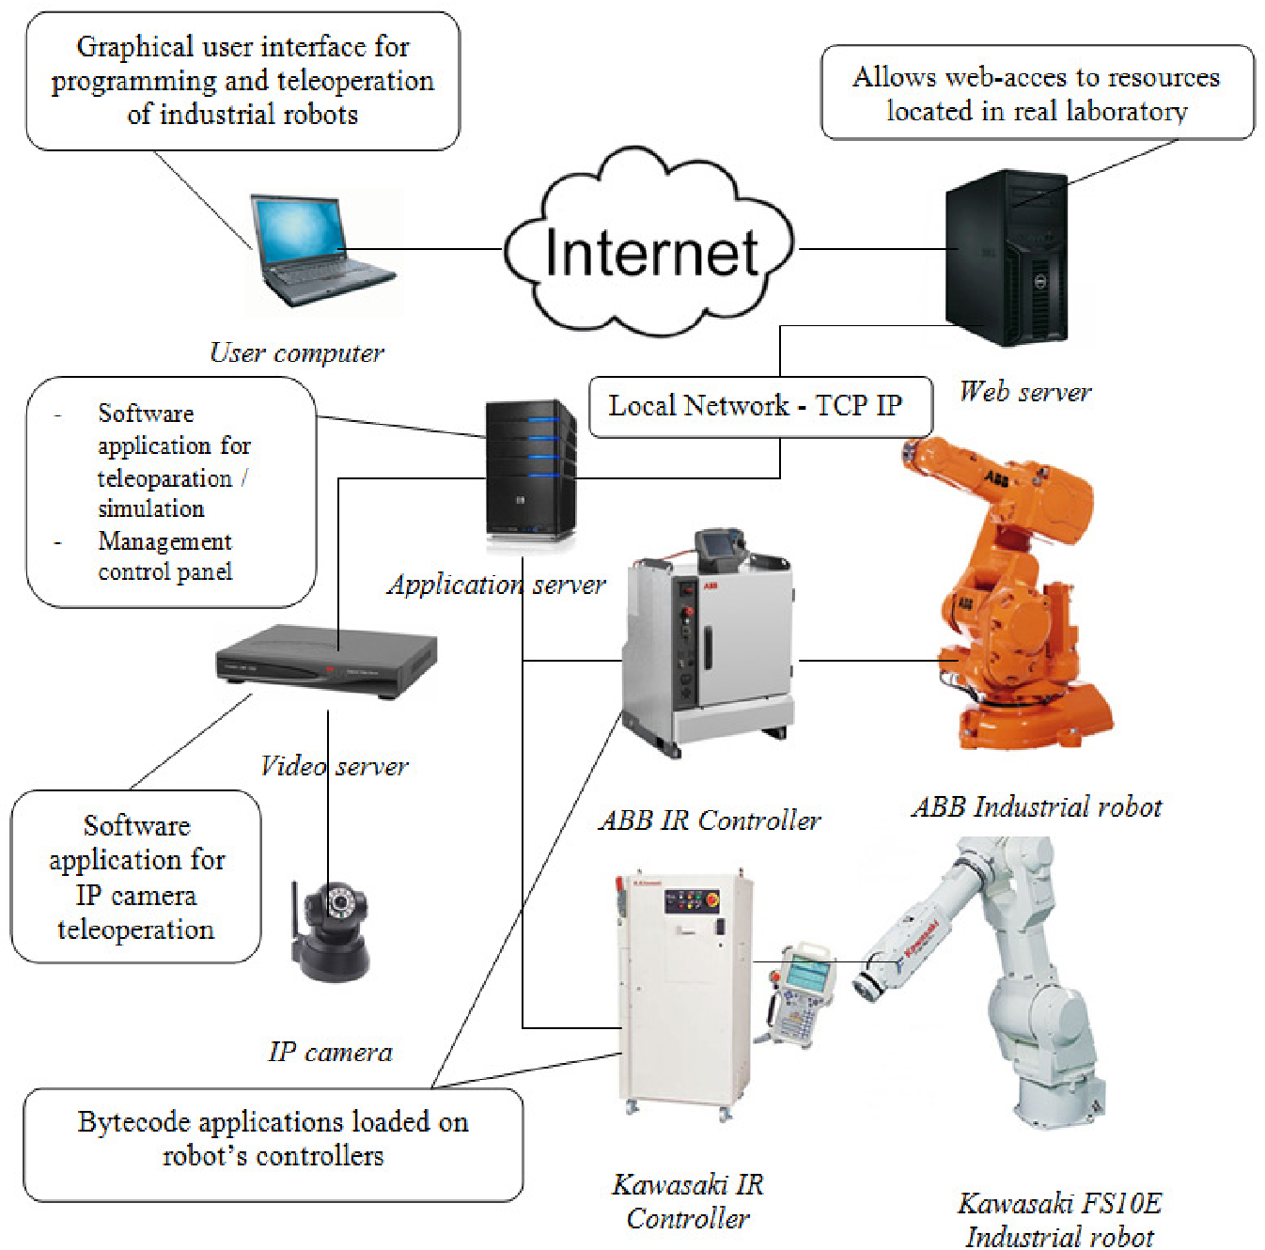

Slide 18
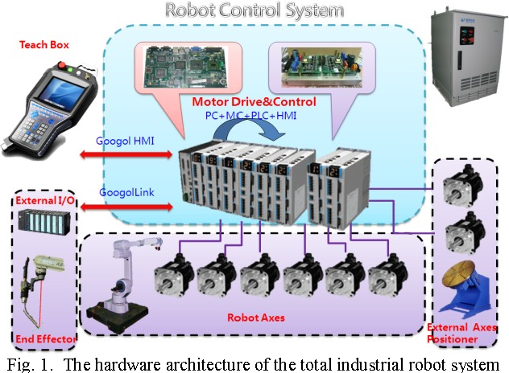

Slide 19
ROBOT DESIGN VS TASKS

Slide 20
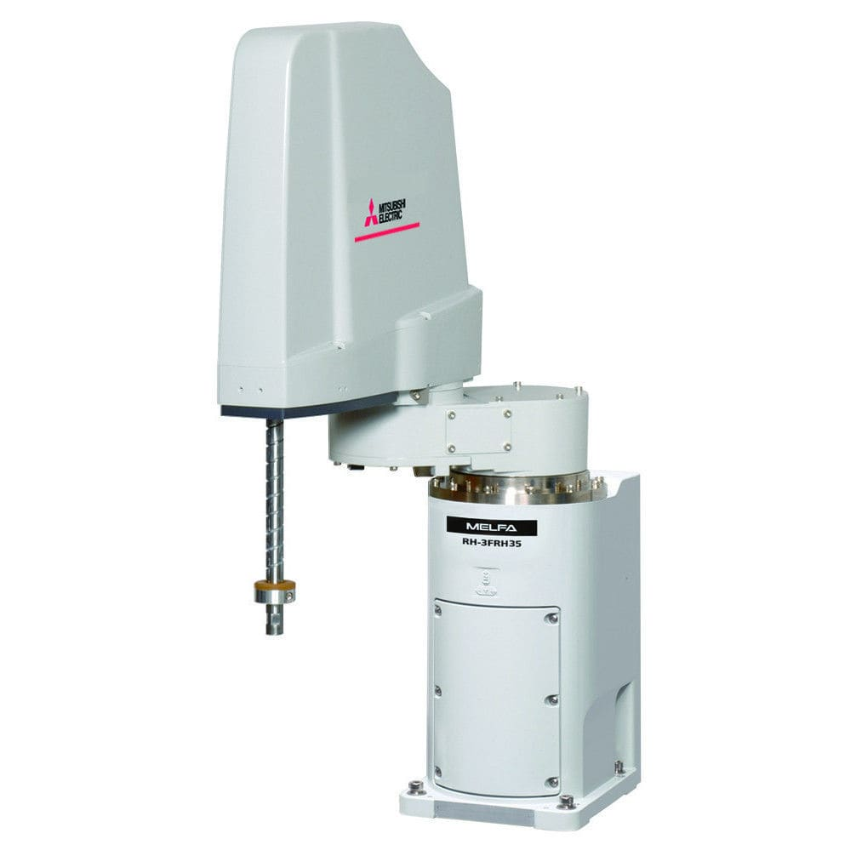
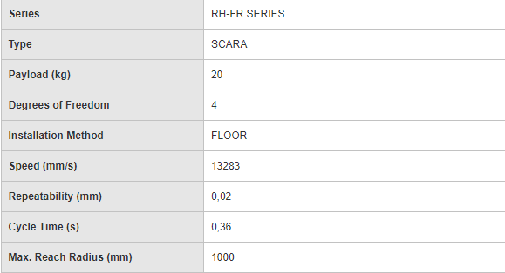
1) Horizontally Articulated(RH-20FRH)
Horizontally Articulated SCARA Robot with MELFA Smart Plus features

Slide 21
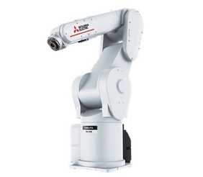
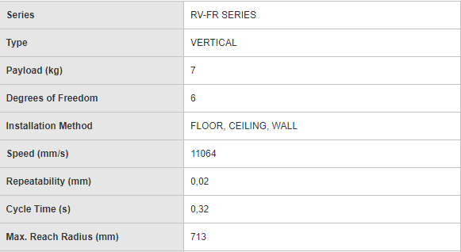
2) Vertically Articulated(RV-7FR)
Vertically Articulated Robot with MELFA Smart Plus features
The RV-FR series offers a highly-dynamic 6-axis articulated robot for a high degree of quality. "Next-generation intelligent functions", "Safe, collaborative work applications", and "FA-IT integration functions". With these 3 key features, the FR Series is capable of handling virtually all your automation needs.

Slide 22
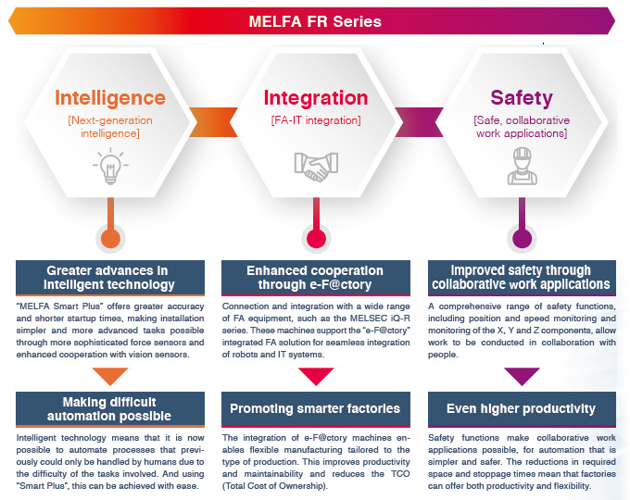

Slide 23
ACTUATORS & LOCOMOTIONS

Slide 24
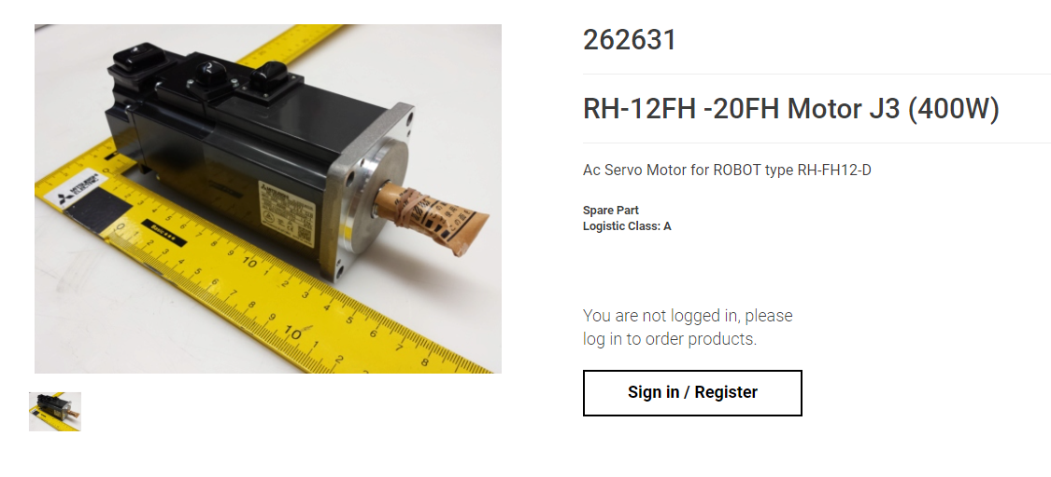
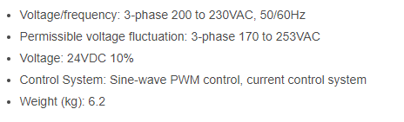
1) AC Servo Motor

Slide 25
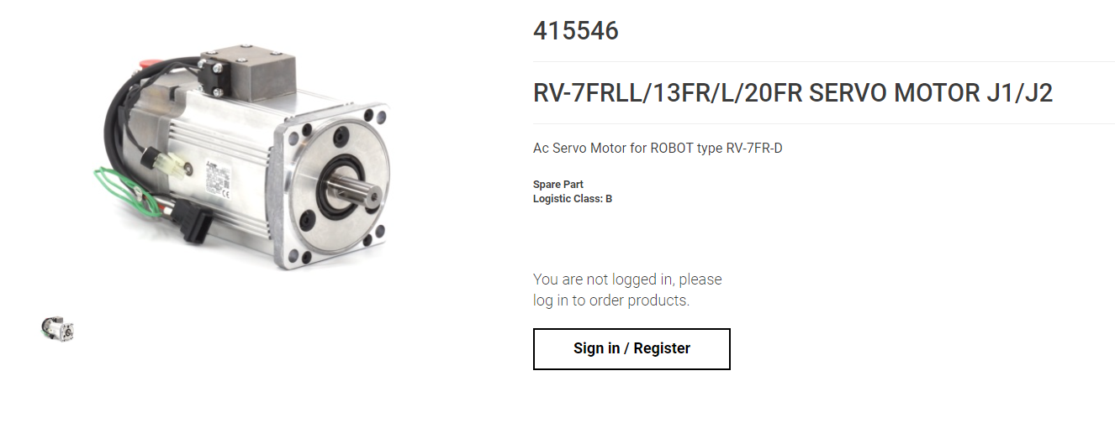

Slide 26
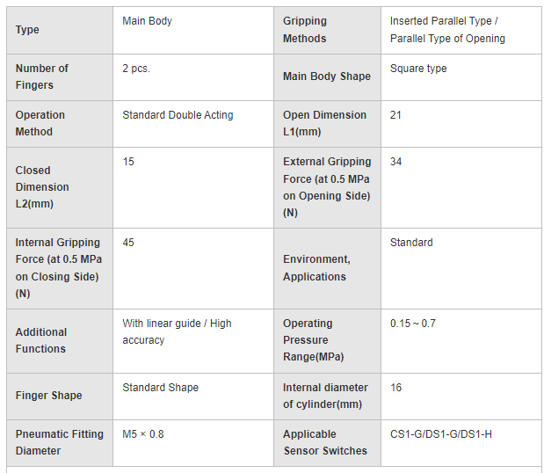
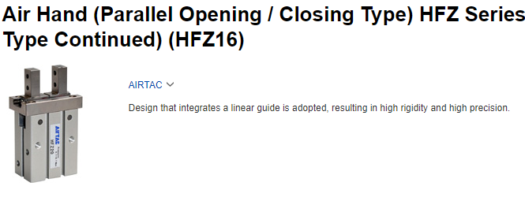
2) Double Acting Pneumatics Gripper
HFZ 16 PARALLEL GRIPPER

Slide 27
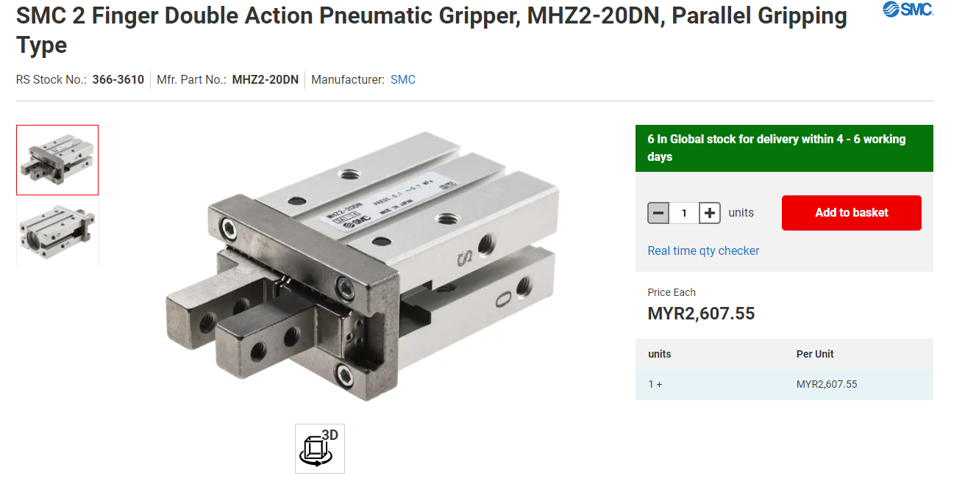
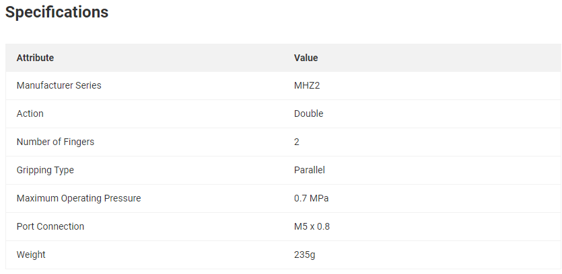
MHZ 2 GRIPPER

Slide 28
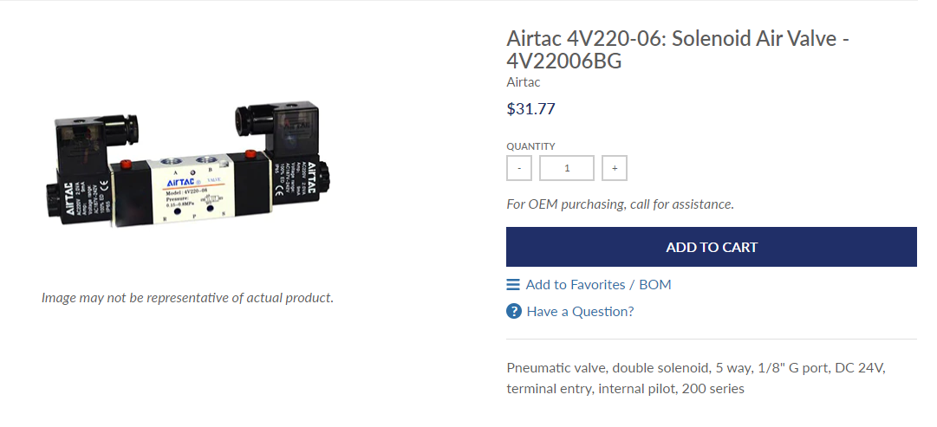
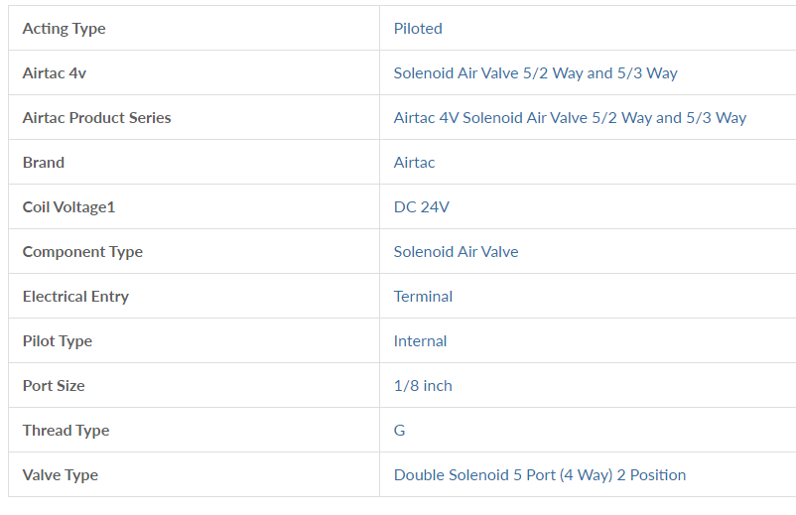
3) Solenoid Air Valve

Slide 29
NAVIGATION SYSTEM & CONTROLLER

Slide 30
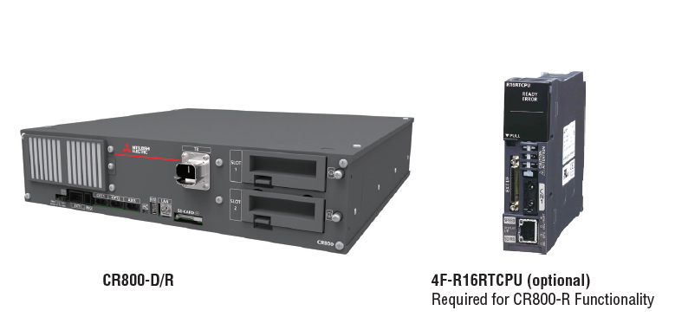
1) CR800-D/R Controller

Slide 31
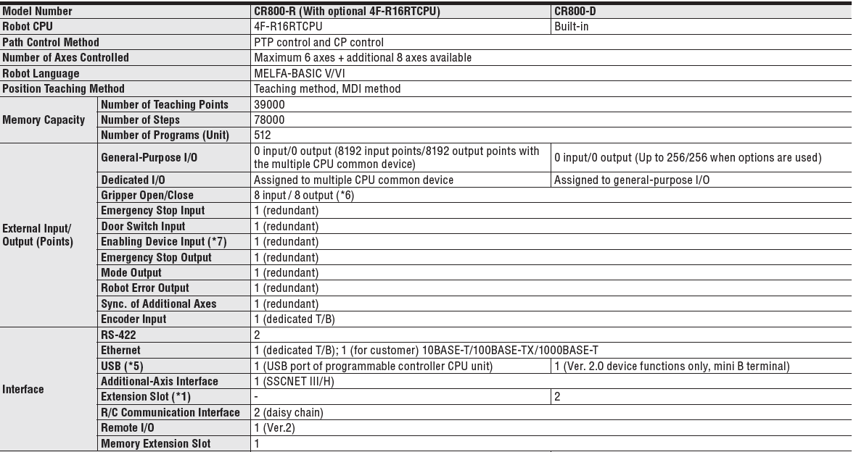

Slide 32
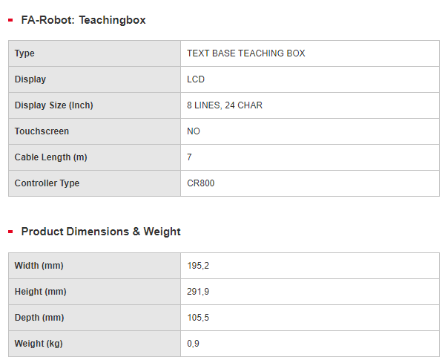
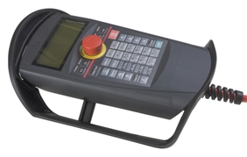
2) Teaching Pendant
R32TB Pendant

Slide 33
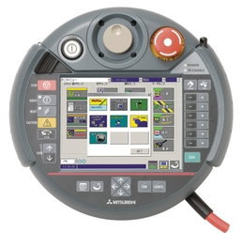
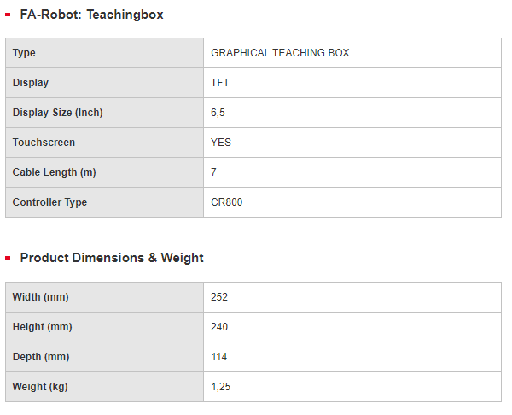
R56TB Pendant

Slide 34
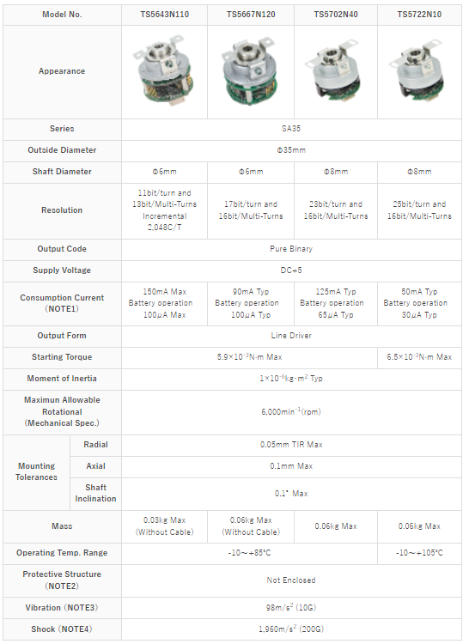
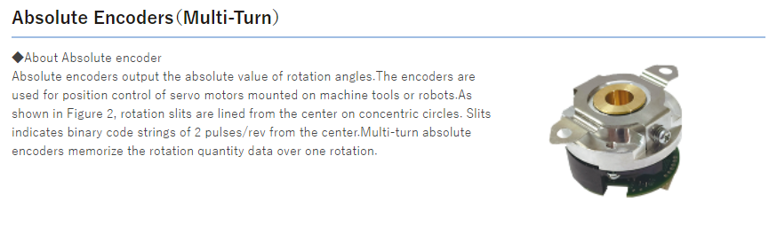
3) Absolute Encoder

Slide 35
DATA COLLECTION

Slide 36
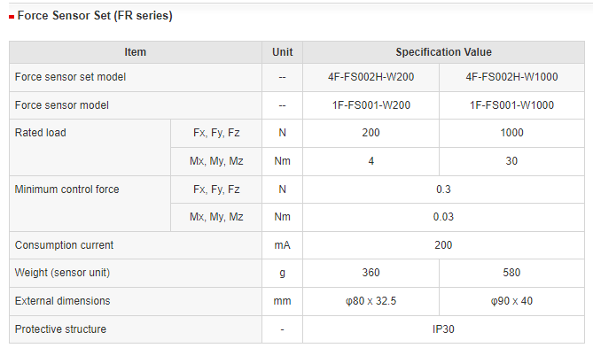
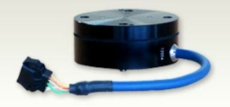
1) Force Sensor Set
Model : 4F-FS002H-W200 and 4F-FS002H-W1000

Slide 37


2) Force Sensor Interface Unit

Slide 38
DATA TRANSMISSION

Slide 39


Slide 40



Slide 41
POWER SYSTEM MANAGEMENT

Slide 42

1) Power Supply
The controller also acts as a power supply to the robot

Slide 43


